Slide 1
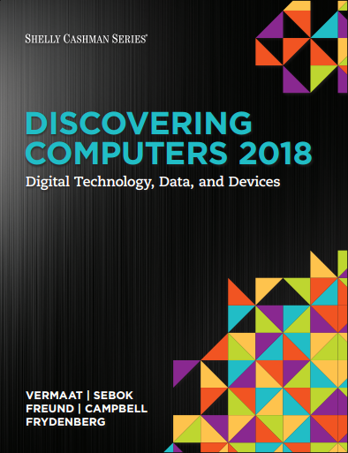

DISCOVERING COMPUTERS 2018 Digital Technology, Data, and Devices
Module 1
Introducing Today’s Technologies
Computers, Devices, and the web
Copyright © 2018 Cengage Learning®. May not be scanned, copied or duplicated, or posted to a publicly accessible website, in whole or in part.

Slide 2
Objectives Overview (1 of 3)
Differentiate among laptops, tablets, desktops, and servers
Describe the purpose and uses of smartphones, digital cameras, portable and digital media players, e-book readers, wearable devices, and game devices
Describe the relationship between data and information
Briefly explain various input options

Slide 3
Objectives Overview (2 of 3)
Differentiate the web from the Internet, and describe the relationship among the web, webpages, websites, and web servers
Explain the purpose of a browser, a search engine, and an online social network
Briefly describe digital security risks associated with viruses and other malware, privacy, your health, and the environment
Differentiate between an operating system and applications

Slide 4
Objectives Overview (3 of 3)
Differentiate between wired and wireless technologies, and identify reasons individuals and businesses use networks
Discuss how society uses technology in education, government, finance, retail, entertainment, health care, science, travel, publishing, and manufacturing
Identify technology used by home users, small/home office users, mobile users, power users, and enterprise users

Slide 5
Today’s Technology (1 of 2)
Because technology changes, you must keep up with the changes to remain digitally literate
Digital literacy involves having a current knowledge and understanding of computers, mobile devices, the web, and related technologies
Notes:
Figure 2.1 Exercise/exercise dropout cycle

Slide 6
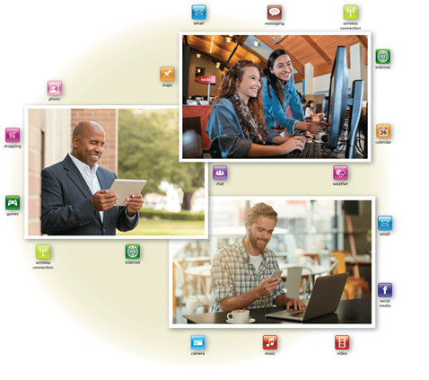
Today’s Technology (2 of 2)
Figure 1-1 People use a variety of computers, mobile devices, and apps every day.

Slide 7
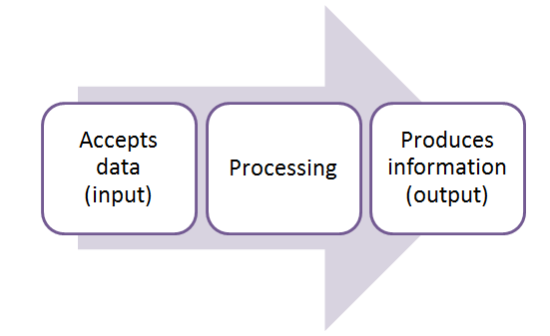
Computers (1 of 5)
A computer is an electronic device, operating under the control of instructions stored in its own memory

Slide 8
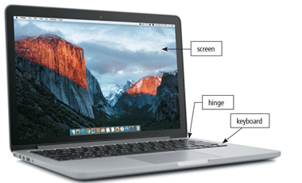
Computers (2 of 5)
Laptop
Figure 1-2 A laptop is a widely used type of computer.

Slide 9
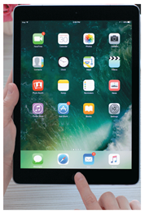
Computers (3 of 5)
Tablet
Figure 1-3 A slate tablet.
Notes:
Our environment is not conducive to a healthy, physically active lifestyle.

Slide 10
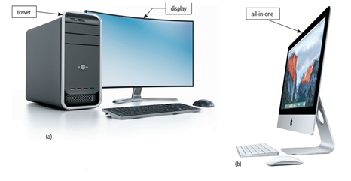
Computers (4 of 5)
Desktop and All-in-One
Figure 1-4 Some desktops have a separate tower; all-in-ones do not.

Slide 11
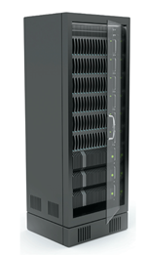
Computers (5 of 5)
Server
Figure 1-5 A server provides services to other computers or devices on a network.

Slide 12
Mobile and Game Devices
Smartphone
Digital camera
Portable and digital media player
E-book reader
Wearable device
Game device

Slide 13
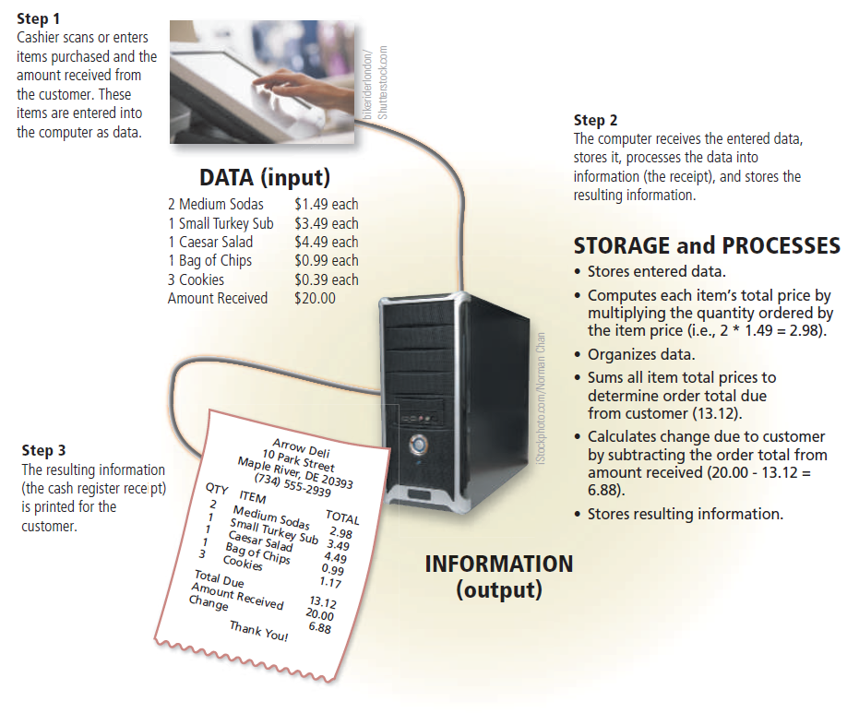
Data and Information (1 of 14)
Figure 1-12 A computer processes data into information. In this simplified example, the item ordered, item price, quantity ordered, and amount received all represent data (input). The computer processes the data to produce the cash register receipt (information, or output).

Slide 14
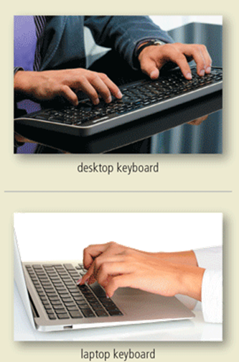
Data and Information (2 of 14)
A keyboard contains keys you press to enter data and instructions into a computer or mobile device

Slide 15
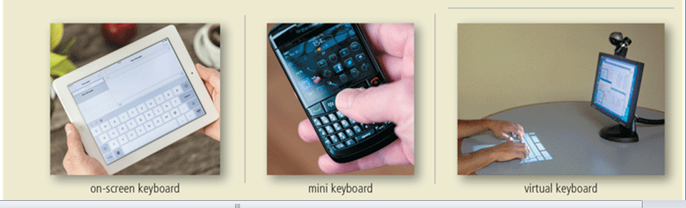
Data and Information (3 of 14)
Figure 1-13 Users have a variety of options for entering typed text.

Slide 16
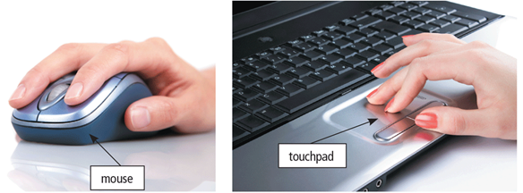
Data and Information (4 of 14)
A pointing device is an input device that allows a user to control a small symbol on a screen, called the pointer
Some mobile devices and computers enable you to speak data instructions using voice input and to capture live full-motion images using video input
Figure 1-14 A mouse and a touchpad.

Slide 17
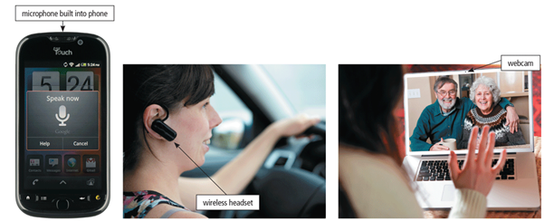
Data and Information (5 of 14)
Figure 1-15 You can speak instructions into a microphone or wireless headset and capture live video on a webcam for a video call.

Slide 18
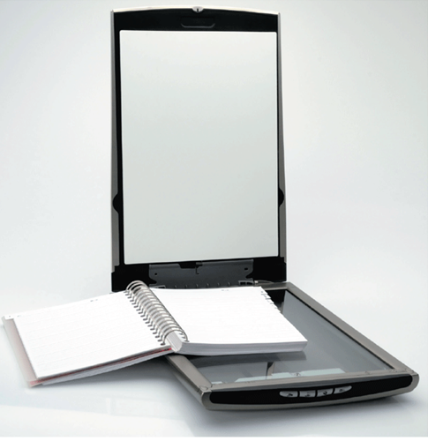
Data and Information (6 of 14)
A scanner is a light-sensing input device that converts printed text and images into a form the computer can process
Figure 1-16 A Scanner.

Slide 19
Data and Information (7 of 14)
An output device is any hardware component that conveys information from a computer or mobile device to one or more people
A printer is an output device that produces text and graphics on a physical medium, such as paper or other material
A 3-D printer can print solid objects, such as clothing, prosthetics, eyewear, implants, toys, parts, prototypes, and more

Slide 20
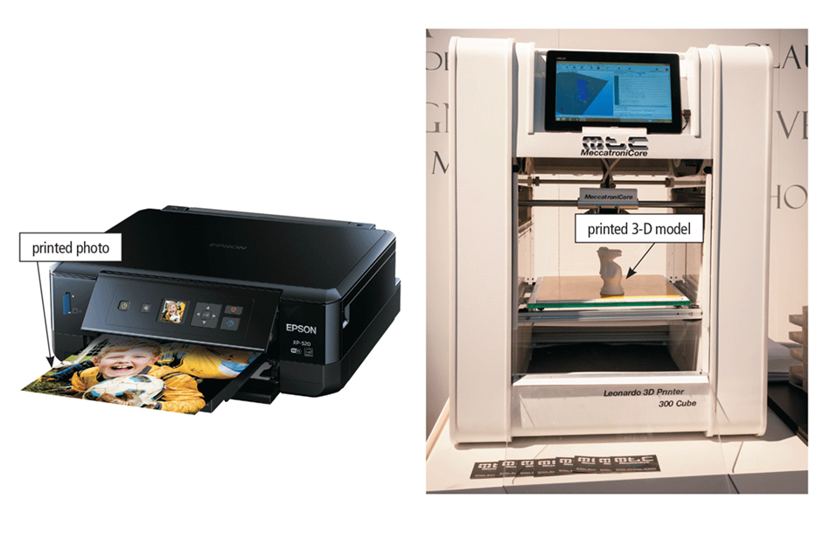
Data and Information (8 of 14)
Figure 1-17 A printer can produce a variety of printed output including photos and 3-D solid objects.

Slide 21
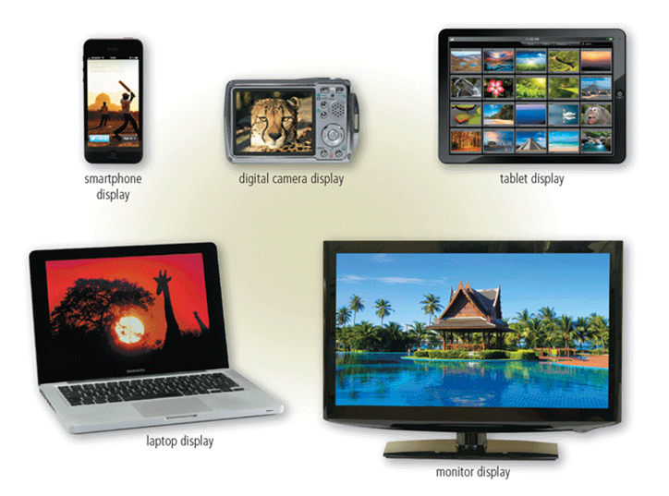
Data and Information (9 of 14)
A display is an output device that visually conveys text, graphics, and video information
Figure 1-18 Displays vary depending on the computer or mobile device.

Slide 22
Data and Information (9 of 14)
A display is an output device that visually conveys text, graphics, and video information
Figure 1-18 Displays vary depending on the computer or mobile device.

Slide 23
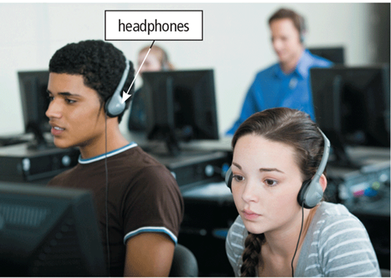
Data and Information (10 of 14)
Speakers allow you to hear audio such as music, voice, and other sounds
Earbuds
Headphones
Figure 1-19 In a crowded environment where speakers are not practical, users can wear headphones to hear music, voice, and other audio.

Slide 24
Data and Information (11 of 14)
Memory consists of electronic components that store instructions waiting to be executed and the data needed by those instructions
A computer keeps data, instructions, and information on storage media
A storage device records (writes) and/or retrieves (reads) items to and from storage media

Slide 25
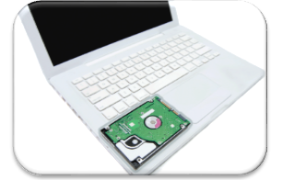
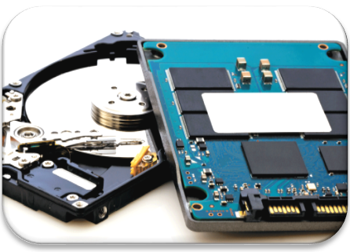
Data and Information (12 of 14)
Hard Disk
Solid-State Drive

Slide 26
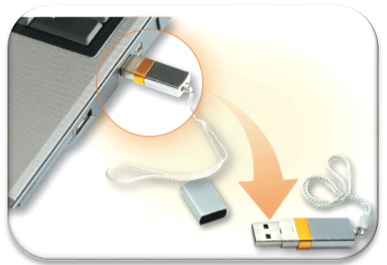
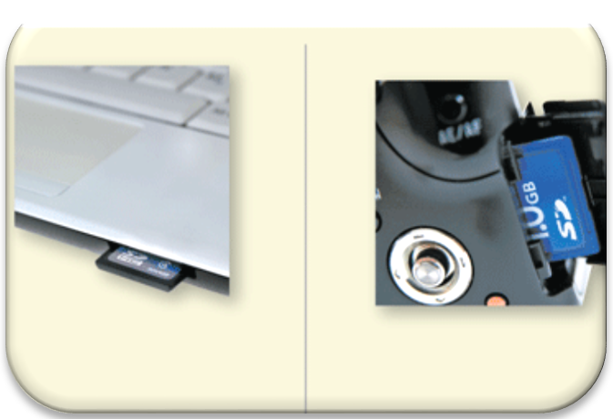
Data and Information (13 of 14)
USB Flash Drive
Memory Card

Slide 27
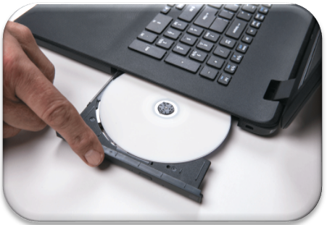
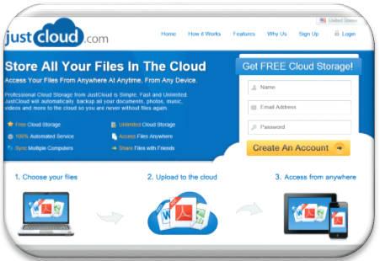
Data and Information (14 of 14)
Optical Disc
Cloud Storage

Slide 28
The Web (1 of 8)
The Internet is a worldwide collection of computer networks that connects millions of businesses, government agencies, educational institutions, and individual

Slide 29
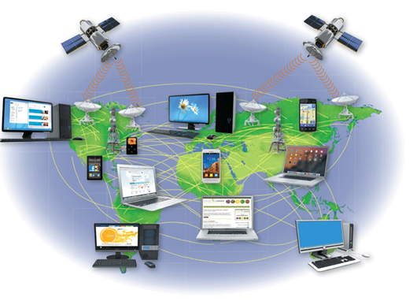
The Web (2 of 8)
Figure 1-27 The Internet is the largest computer network, connecting millions of computers and devices around the world.

Slide 30
The Web (3 of 8)
The World Wide Web (or web, for short) is a global library of information available to anyone connected to the Internet
The web consists of a worldwide collection of electronic documents, each of which is called a webpage
A website is a collection of related webpages
A web server is a computer that delivers requested webpages to your computer or mobile device

Slide 31
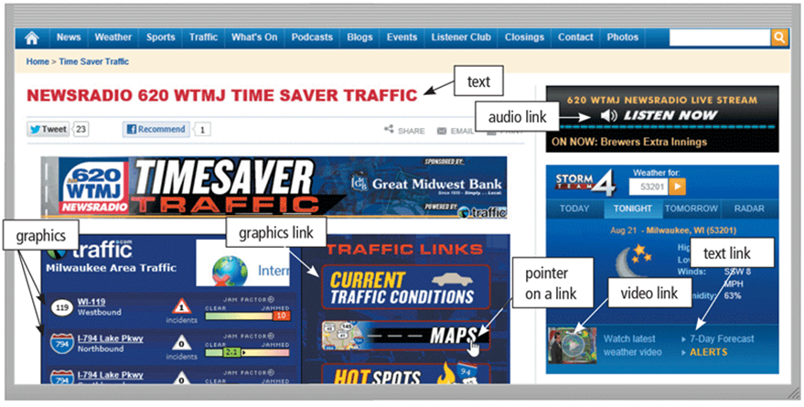
The Web (4 of 8)
Figure 1-28 Webpages, such as the one shown here, can display text, graphics, audio, and video on a computer or mobile device. Pointing to a link on the screen typically changes the shape of the pointer to a small hand with a pointing index finger.
Notes:
Figure 2.3 Stages of change model

Slide 32
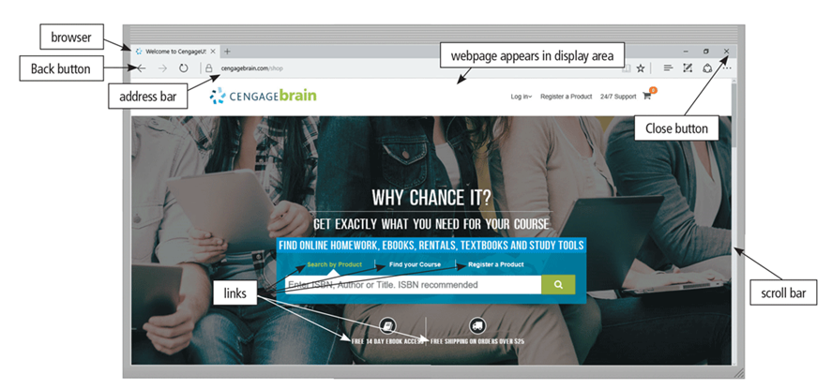
The Web (5 of 8)
A browser is software that enables users with an Internet connection to access and view webpages on a computer or mobile device

Slide 33
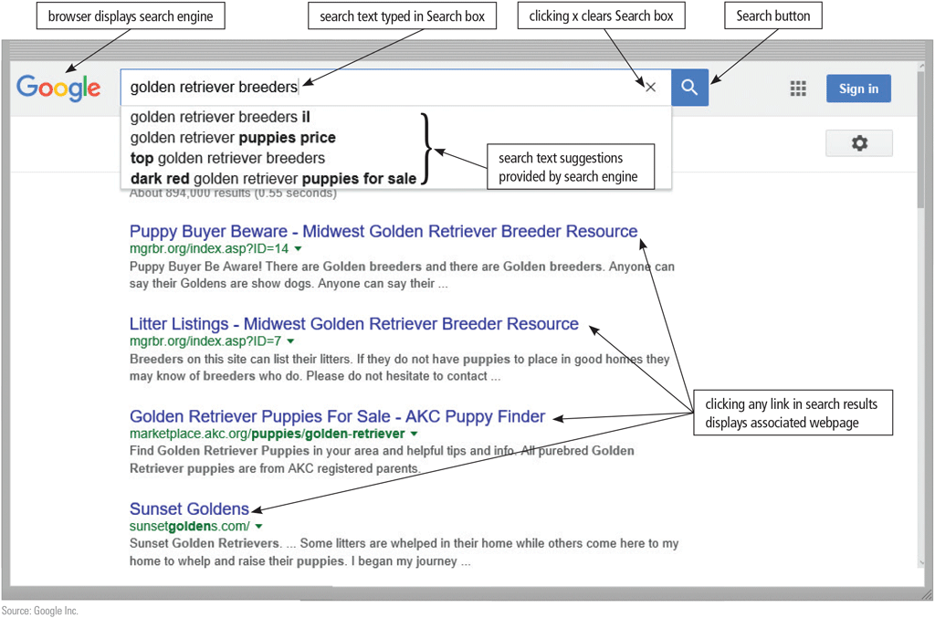
The Web (6 of 8)
A search engine is software that finds websites, webpages, images, videos, news, maps, and other information related to a specific topic

Slide 34
The Web (7 of 8)
An online social network, also called a social networking site, is a website that encourages members in its online community to share their interests, ideas, stories, photos, music, and videos with other registered users

Slide 35
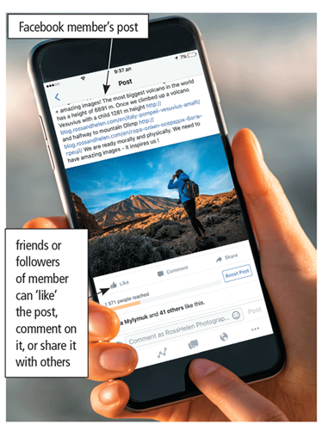
The Web (8 of 8)
Figure 1-29 When Facebook users share, comment on, or “like” a post, the post appears on their own personal Facebook pages.

Slide 36
Digital Safety and Security (1 of 2)
It is important that users protect their computers and mobile devices
Viruses and Other Malware
Privacy
Health Concerns
Environmental Issues

Slide 37
Digital Safety and Security (2 of 2)
Green computing involves reducing the electricity consumed and environmental waste generated when using a computer
Strategies include:
Recycling
Using energy efficient hardware and energy saving features
Regulating manufacturing processes
Extending the life of computers
Immediately donating or properly disposing of replaced computers
Notes:
Figure 2.4 Goal setting and supportive behaviors

Slide 38
Programs and Apps (1 of 6)
Software, also called a program, tells the computer what tasks to perform and how to perform them
System Software
Operating system
Tools

Slide 39
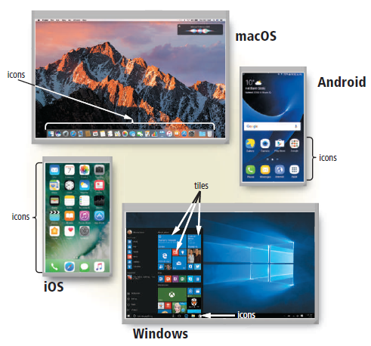
Programs and Apps (2 of 6)
Figure 1-30 Shown here are the macOS and Windows operating systems for laptops and desktops and the Android and iOS operating systems for smartphones. You interact with these operating system interfaces by clicking or tapping their icons or tiles.

Slide 40
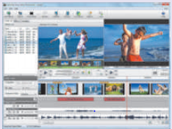
Programs and Apps (3 of 6)
Applications

Slide 41
Programs and Apps (4 of 6)
Installing a program is the process of setting up the program to work with a computer or mobile device, printer, and/or other hardware
Once installed, you can run a program so that you can interact with it
You interact with a program through its user interface
Notes:
Figure 2.5 Model of progression and relapse

Slide 42
Programs and Apps (5 of 6)
A software developer, sometimes called a developer or programmer, is someone who develops programs and apps or writes the instructions that direct the computer or mobile device to process data into information

Slide 43
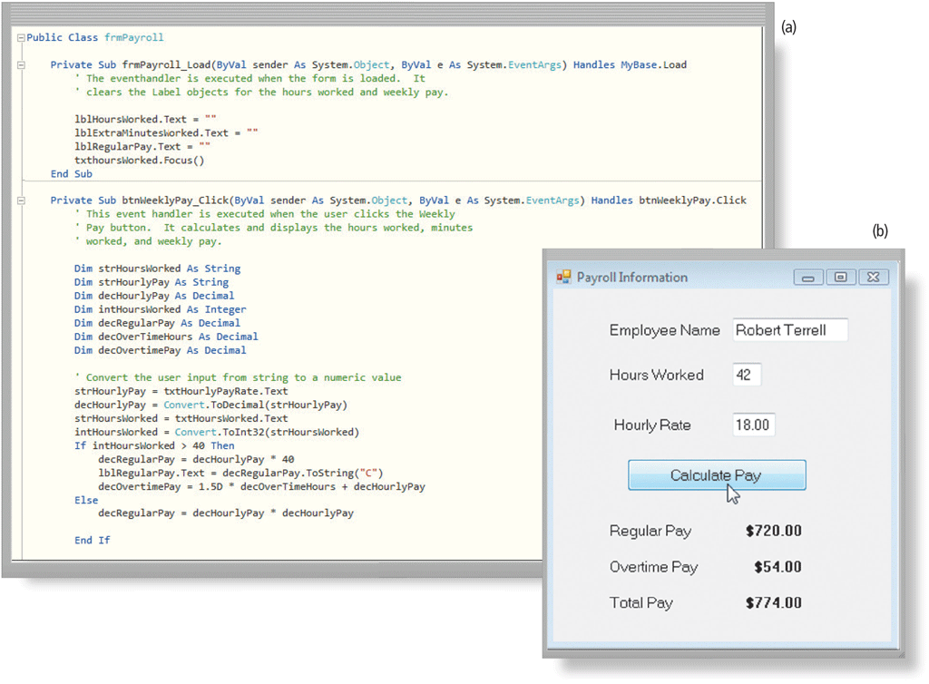
Programs and Apps (6 of 6)
Figure 1-31 A software developer writes instructions using Visual Basic (a) to create Payroll Information window shown here (b).

Slide 44
Communications and Networks (1 of 7)
In the course of a day, it is likely you use, or use information generated by, one or more of these communications technologies
Chat rooms
Email
Fax
FTP
GPS

Slide 45
Communications and Networks (2 of 8)
Instant messaging
Internet
Newsgroups
RSS
Videoconference
Voice mail
VoIP

Slide 46
Communications and Networks (3 of 8)
A communications device is hardware capable of transferring items from computers and devices to transmission media and vice versa

Slide 47
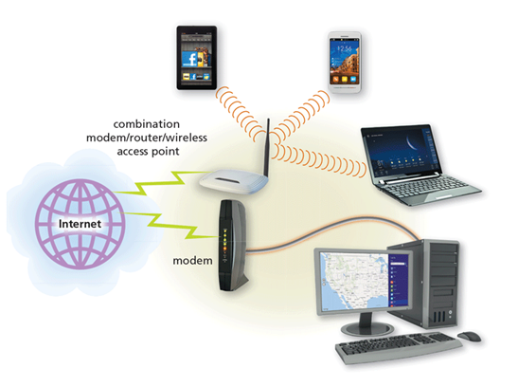
Communications and Networks (4 of 8)
Figure 1-32 Modems, wireless access, and routers are examples of communications devices that enable communications between computers/ mobile devices and the Internet. Notice that some computers and devices communicate via wires, and others communicate wirelessly.

Slide 48
Communications and Networks (5 of 8)
Examples of wireless communications technologies include:
Wi-Fi
Bluetooth
Cellular radio

Slide 49
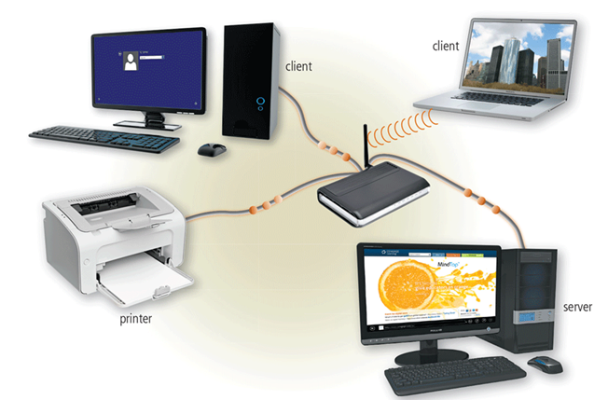
Communications and Networks (6 of 8)
A network is a collection of computers and devices connected together, often wirelessly, via communications devices and transmission media
Figure 1-33 A server manages the resources on a network, and clients access the resources on the server. This network enables three separate computers to share the same printer, one wirelessly.

Slide 50
Communications and Networks (7 of 8)
Home Networks
Connect to the Internet
Share a single high-speed Internet connection
Access photos, music, videos, and other content
Share devices
Play multiplayer games
Connect game consoles to the Internet
Subscribe to and use VoIP
Interact with other devices in a smart home

Slide 51
Communications and Networks (8 of 8)
Business Networks
Facilitate communications
Share hardware
Share data, information, and software
Notes:
Table 2.2 Sample Techniques for Use with Process of Change

Slide 52
Technology Uses
Education
Government
Finance
Retail
Entertainment
Health Care
Science
Travel
Publishing
Manufacturing
Notes:
Table 2.2 Sample Techniques for Use with Process of Change

Slide 53


Technology Users (1 of 3)
Home User
Small/Home Office User

Slide 54

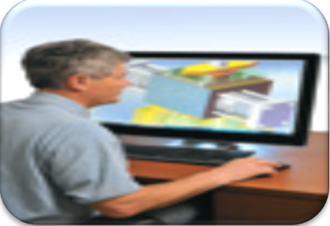
Technology Users (2 of 3)
Mobile User
Power User

Slide 55

Technology Users (3 of 3)
Enterprise Use

Slide 56
Summary
Basic computer concepts
Various methods for input, output, memory, and storage
The Internet
Digital security and safety risks and precautions
Uses of technology applications in society

